Slide 1

Chicago
Crime Data Visualization
-
Main Results and Recommendations
by
Rubiya Riaz
Academic Year 2017/2018

Slide 2
THE SCOPE OF THE ANALYSIS
Data Preparation and Constraints
Sources
23 variables
And around 1.5million observations
City of Chicago Data Portal (2012-2017)
Chicago Map with Boundaries and Districts
News articles
01
03
Few Important variables
Crime Type (Primary & Secondary)
Geographical location of crime
Date of crime
Arrest made or not
Constraints
Data cleaning and preparation
Data Size difficulty plotting
Few missing geographical points
01
03
Basic Tools Used
Rprogramming in RStudio
SQL library in RStudio
01
Visualization
03

Slide 3
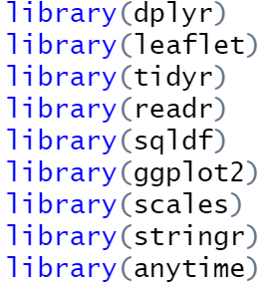
Setting up environment
-install R and Rstudio
-create R project and set working directory (wd)
-install and load relevant libraries for SQL, date-time
manipulation, plotting, maps..
install.packages(“library_name”)
library(library_name)
-download dataset in .csv format to the work directory

Slide 4
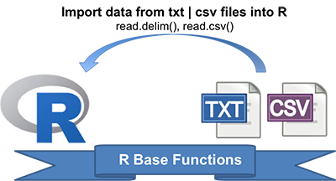
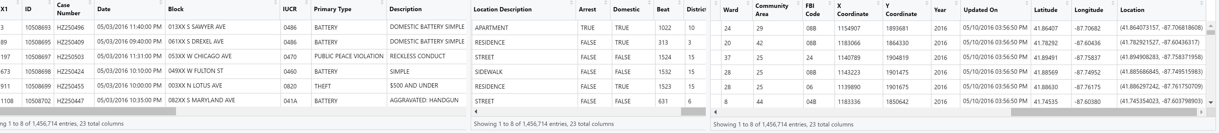
READING DATA
-read CSV in RStudio
crime-> read_csv("crimes-in- chicago/Chicago_Crimes_2012_to_2017.csv")
-View data using View(crime) function

Slide 5
Cleaning Data
1
Remove missing geographical points
2
Remove spaces from column names
drop_na Function used along with tunneling:
data <- crime %>% drop_na(Latitude) %>% drop_na(Longitude)
names(data) = gsub(" ", "", names(data))
With this method:
Around 36000 observations dropped
Improvement in ease of analysis
Data set relatively compact

Slide 6
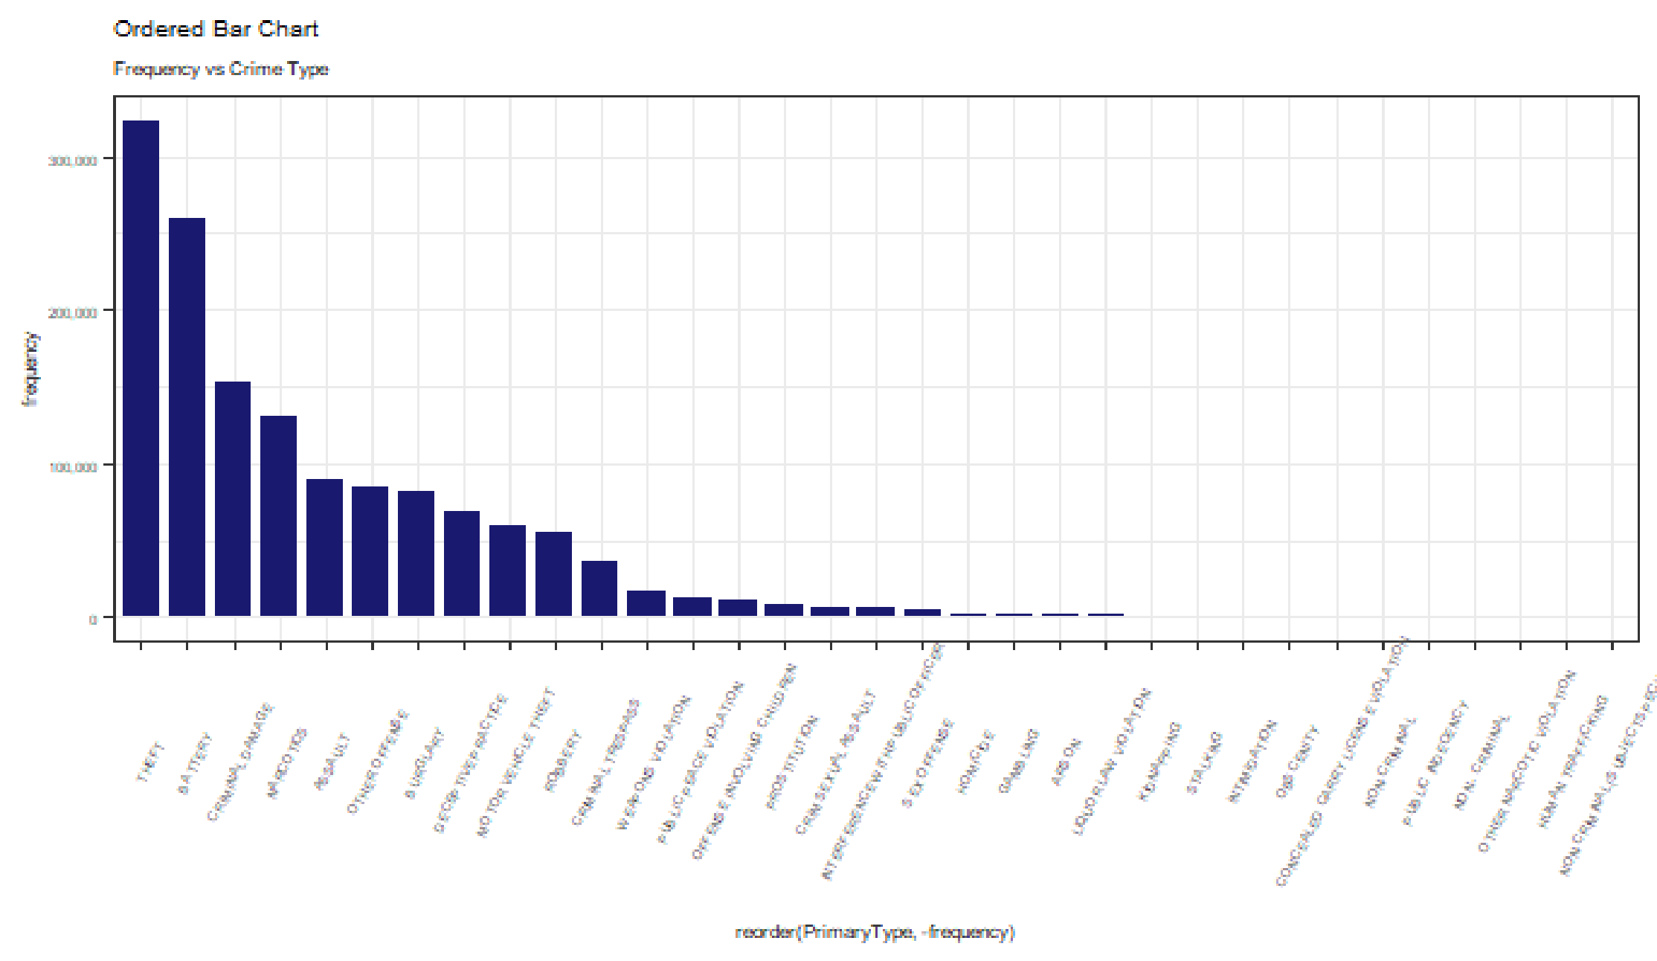
Primary Analysis
Discovery during primary analysis…
- 33 types of crimes (sql query)
-crimes varying in frequency
-top crimes include theft, battery, criminal damage, narcotics
SQL code:
data1 = sqldf("Select PrimaryType , count(*) as frequency
from data
group by PrimaryType")
ggplot code with layers:
ggplot(data1, aes(x=reorder(PrimaryType, -frequency), y=frequency)) +
geom_bar(stat="identity", width=0.8, fill="#191970") +
labs(title="Ordered Bar Chart",
subtitle="Frequency vs Crime Type") +
theme(axis.text.x=element_text(angle=65, vjust=0.6), text = element_text(size=6))

Slide 7
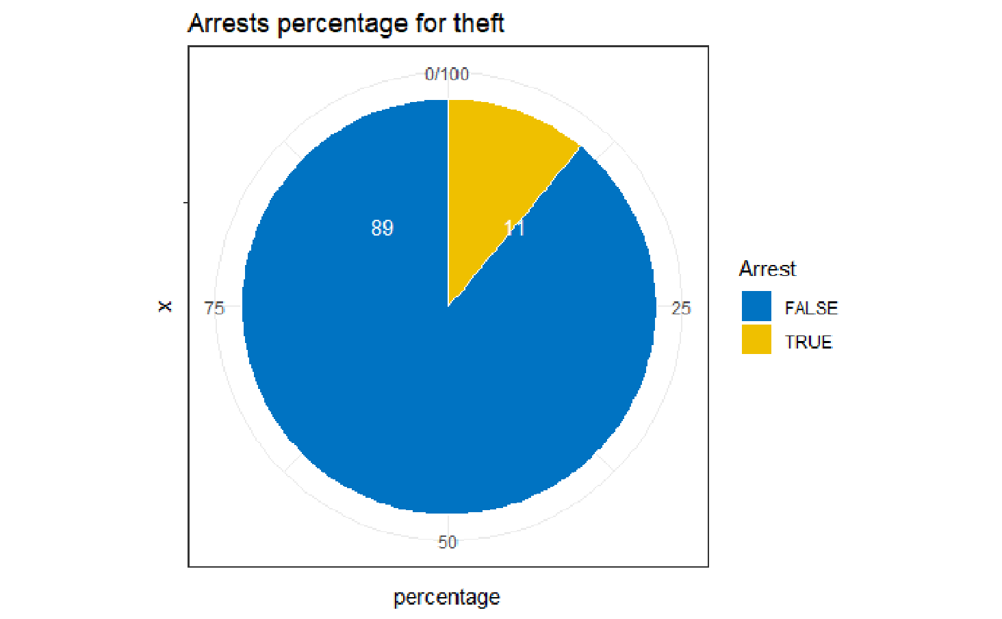
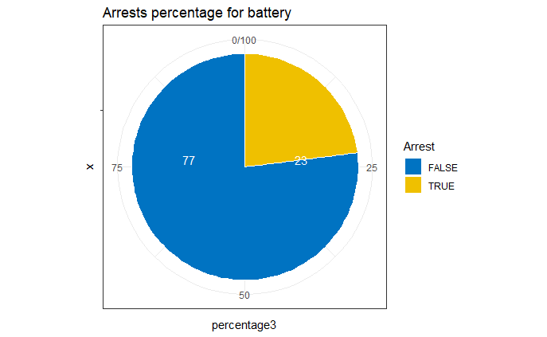
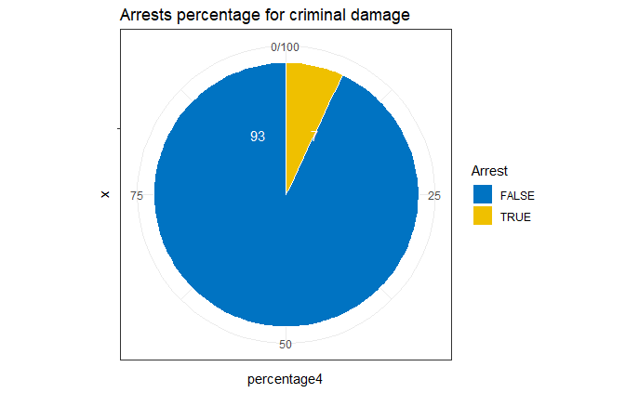
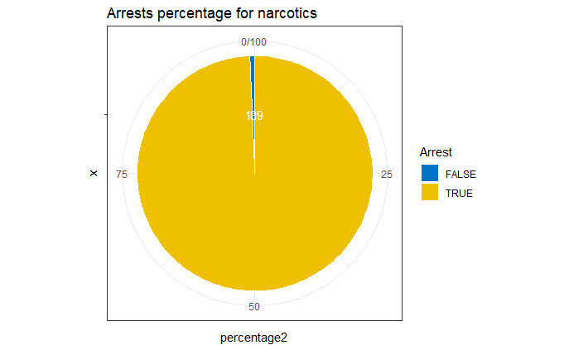
Secondary Analysis- Arrest Percentage for top crimes
Take Away:
Only narcotics with a good arrest rate
Rest top crimes with less than 25% arrest rate
Sample sql query for Criminal Damage
data6 <- sqldf("Select PrimaryType, Arrest, count(Arrest) as nfrequency
from data
where PrimaryType='CRIMINAL DAMAGE'
group by Arrest")
Pie Chart ggplot code
mycols <- c("#0073C2FF", "#EFC000FF")
ggplot(data6, aes(x = "", y = percentage4, fill = Arrest)) +
geom_bar(width = 1, stat = "identity", color = "white") +
coord_polar("y", start = 0)+
geom_text(aes( label =percentage4), color = "white")+
scale_fill_manual(values = mycols) +
labs(title="Arrests percentage for criminal damage")
theme_void()

Slide 8
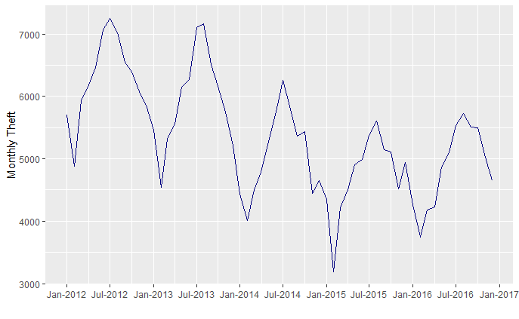
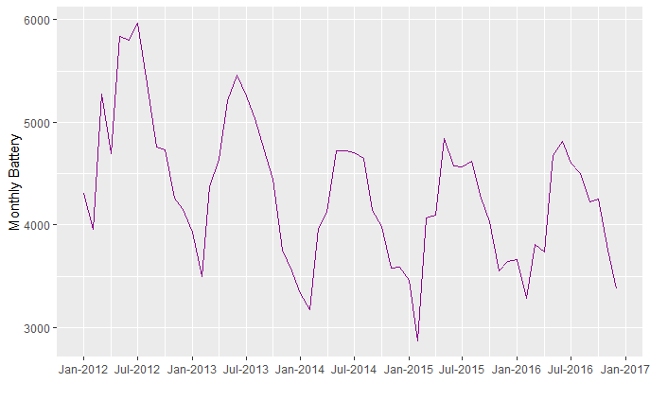
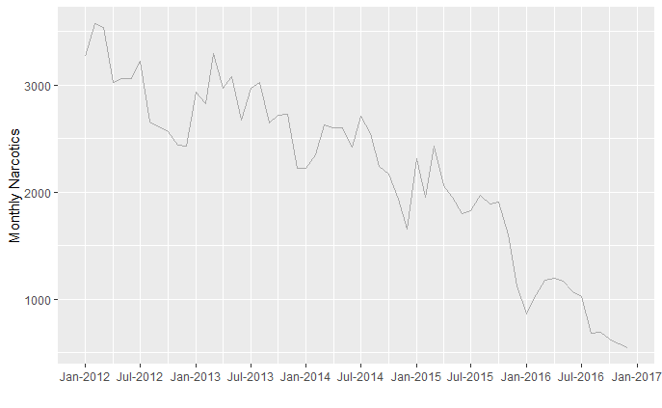
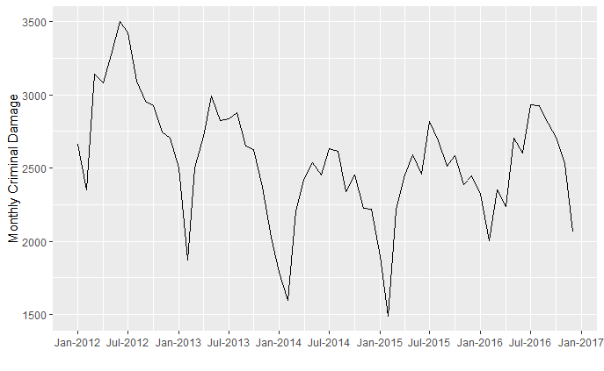
Secondary Analysis- Time Series Analysis of Top Crimes
Take Away
-Narcotics is the only crime with significant reduction over time
-Other top crimes have seen a reduction with time but it is not relatively significant
SQL query to find
Criminal Damage Frequency based on Month and Year
criminaldamage <- sqldf ("Select t, count(*) AS tfreq
from data
where PrimaryType='CRIMINAL DAMAGE'
group by t
order by t ASC")
##t here is the date in month-yr format
Plotting criminal damage vs time
ggplot(criminaldamage, aes(x=criminaldamage$t,y=criminaldamage$tfreq)) +
geom_line(col="#000000") +
scale_x_date(date_labels = "%b-%Y",
breaks = pretty(criminaldamage$t, n = 10)) + xlab("") + ylab("Monthly Criminal Damage")+theme_grey()

Slide 9
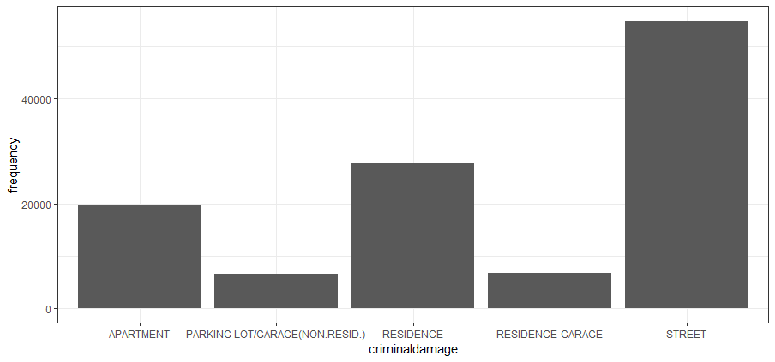
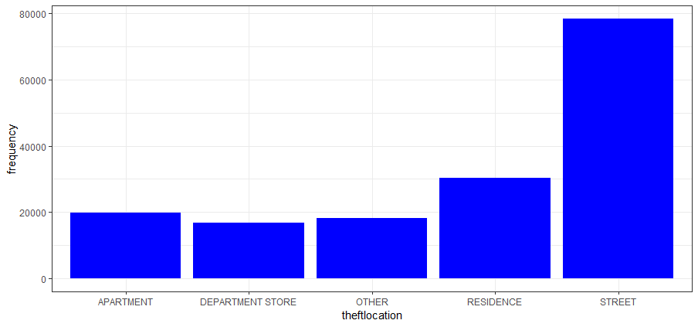
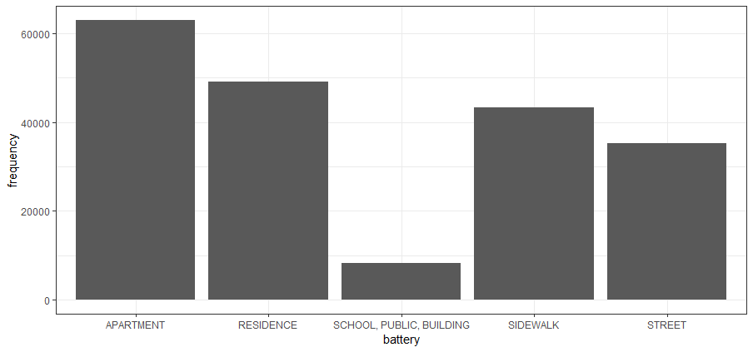
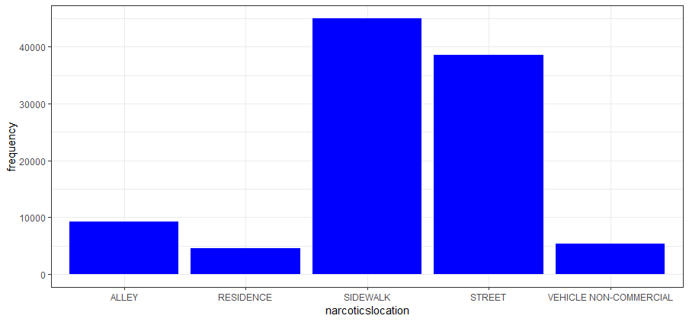
Secondary Analysis contd. Top Crimes by Location
Take Away
-Street most dangerous location for criminal damage and theft crimes.
-Battery most frequent in apartments
-Narcotics most frequent on sidewalks
SQL query to find most dangerous theft locations
theftloc = sqldf("Select LocationDescription as theftlocation,
count(*) as frequency
from data
where PrimaryType='THEFT'
group by LocationDescription
order by frequency DESC
limit 5")
GGPLOT command
ggplot(theftloc,aes(theftlocation,frequency))+
geom_bar(stat='identity',fill="blue")

Slide 10
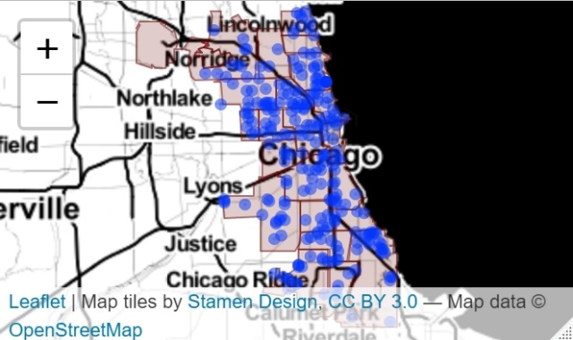
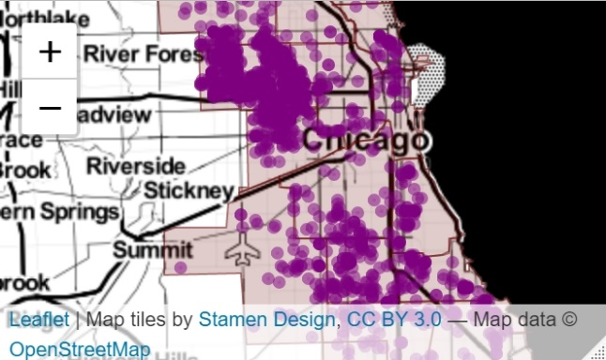
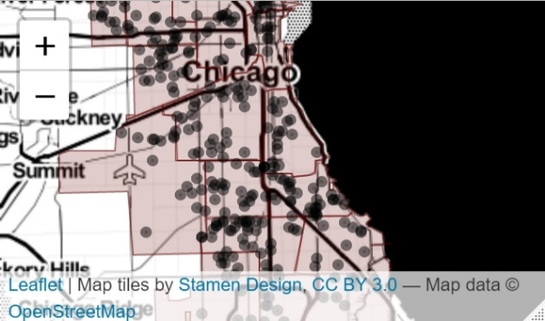
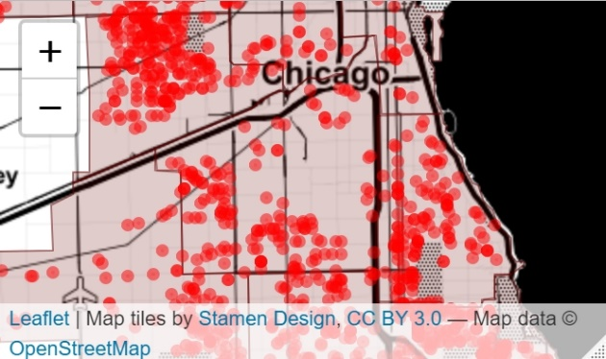
Tertiary Analysis: Plotting Crime using previous results
Theft in streets, year 2016 with arrests made,
Most prevalent along the harbour.
Narcotics on sidewalks, year 2016 with arrests made. Most prevalent:
-West Roosevelt Road
-Harbour
Criminal Damage in streets, year 2016 with arrests made.
Most dense areas:
-West Roosevelt road
-West 71st
-Grant park
Battery in apartments, year 2016 with arrests made.
Areas:
-East 79th Street
-West Roosevelt Road

Slide 11
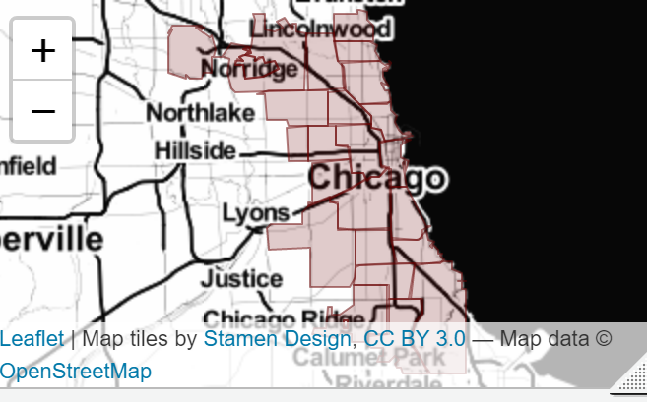
Tertiary Analysis contd.
Code:
bnd <- readOGR("pd.geojson") ##function of rgdal library to read basic map of chicago
##leaflet() function to plot basic map of chicago
m<-leaflet() %>% addProviderTiles(providers$Stamen.Toner) %>%
addPolygons(data=bnd, color="#690000", weight=1,)+
addCircleMarkers(data = bnd, popup = popupTable(bnd))
##sql query to get highest theft locations for year=2016,location=Street,Arrest=1
maptheft = sqldf("Select Latitude, Longitude
from data
where Year=2016 and
PrimaryType='THEFT'
and LocationDescription='STREET' and
Arrest=1")
##plot above the basic plot
m %>% addCircleMarkers(lng=maptheft$Longitude,lat=maptheft$Latitude,radius=0)

Slide 12


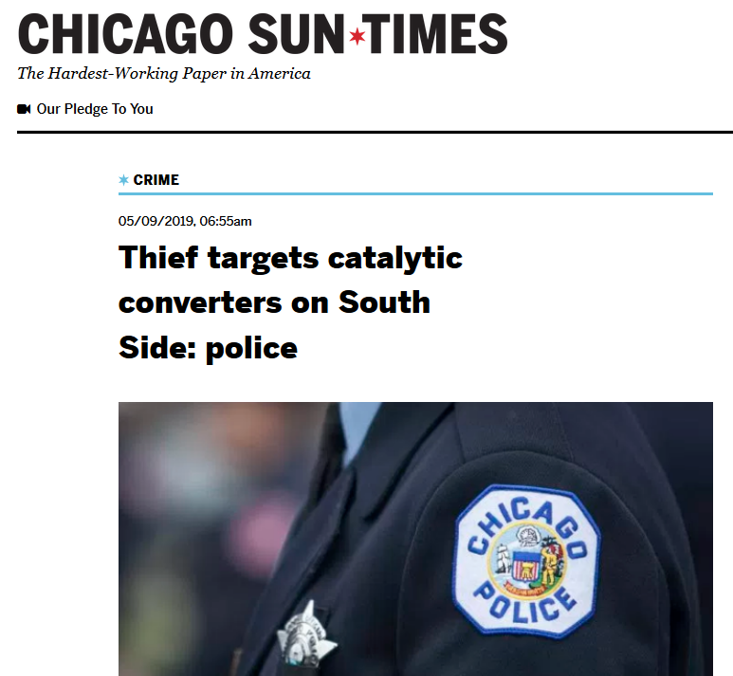
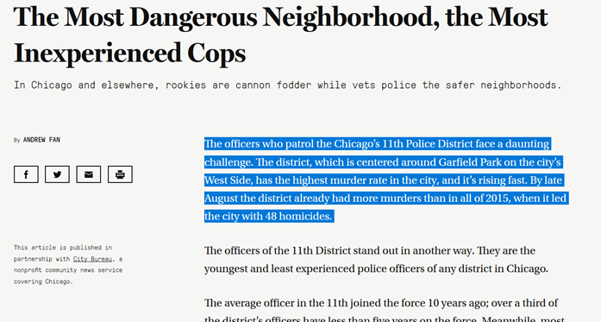
News to cross-check direction of analysis

Slide 13
RESULTS AND CONCLUSION
3 levels of analysis performed
Limitations of the analysis
Recommendations
$
$
Limited dataset considered
Consider the entire dataset available from 2001-present rather than 2012-2017
Theft, Battery, Criminal Damage and Narcotics most frequent crimes
>60% occurrences combined
Structured approach regarding the geographic mapping and possible clustering
Relies more on aggregate data rather than trends
Lacking in arrest rate expect Narcotics
Less than 25% generally
Good control on Narcotics with time
3200 incidents/month to 500/month in 5 years!
Visualize others perspectives of Police resources vs Efficiency OR
Area Economic Demographic vs Crime.
Spatial partition simplification
Streets and sidewalks most unsafe.
Dangerous areas are West Roosevelt Road and Harbour Area.

Slide 14
THANKS FOR YOUR ATTENTION

